Slide 1
Firm Name:
ABC Engineering
Project Name: Cuomo Bridge
Project Location: ABC, NY

Slide 2
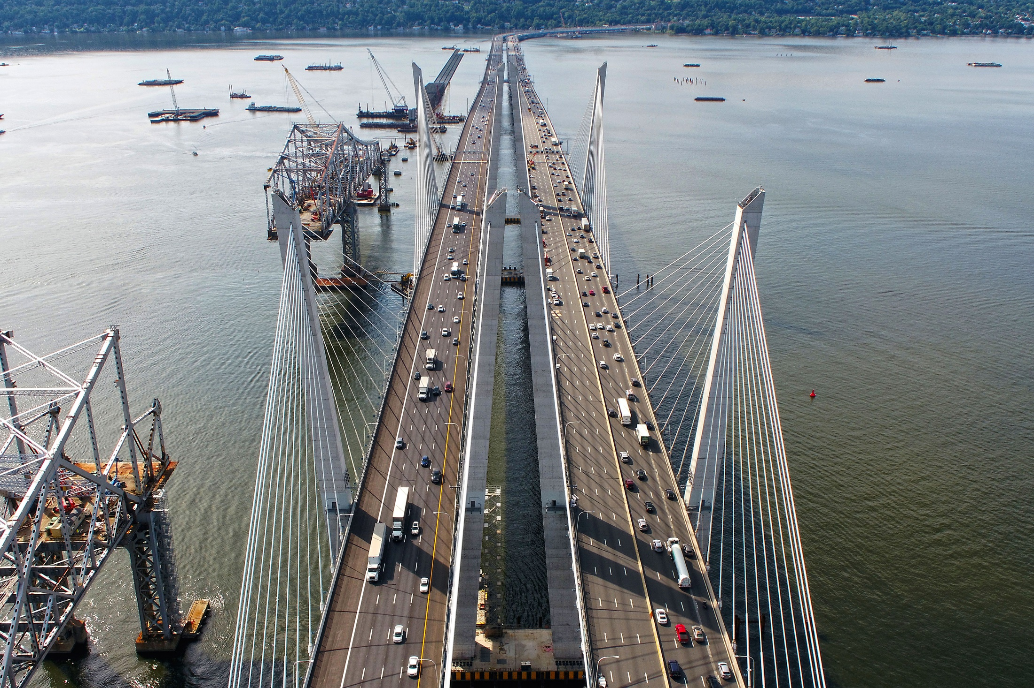
Photo 1 – (include description)

Slide 3
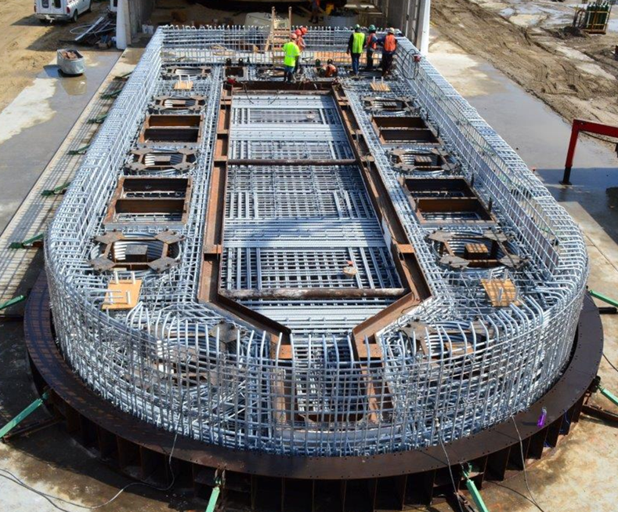
Photo 2 – (include description)

Slide 4
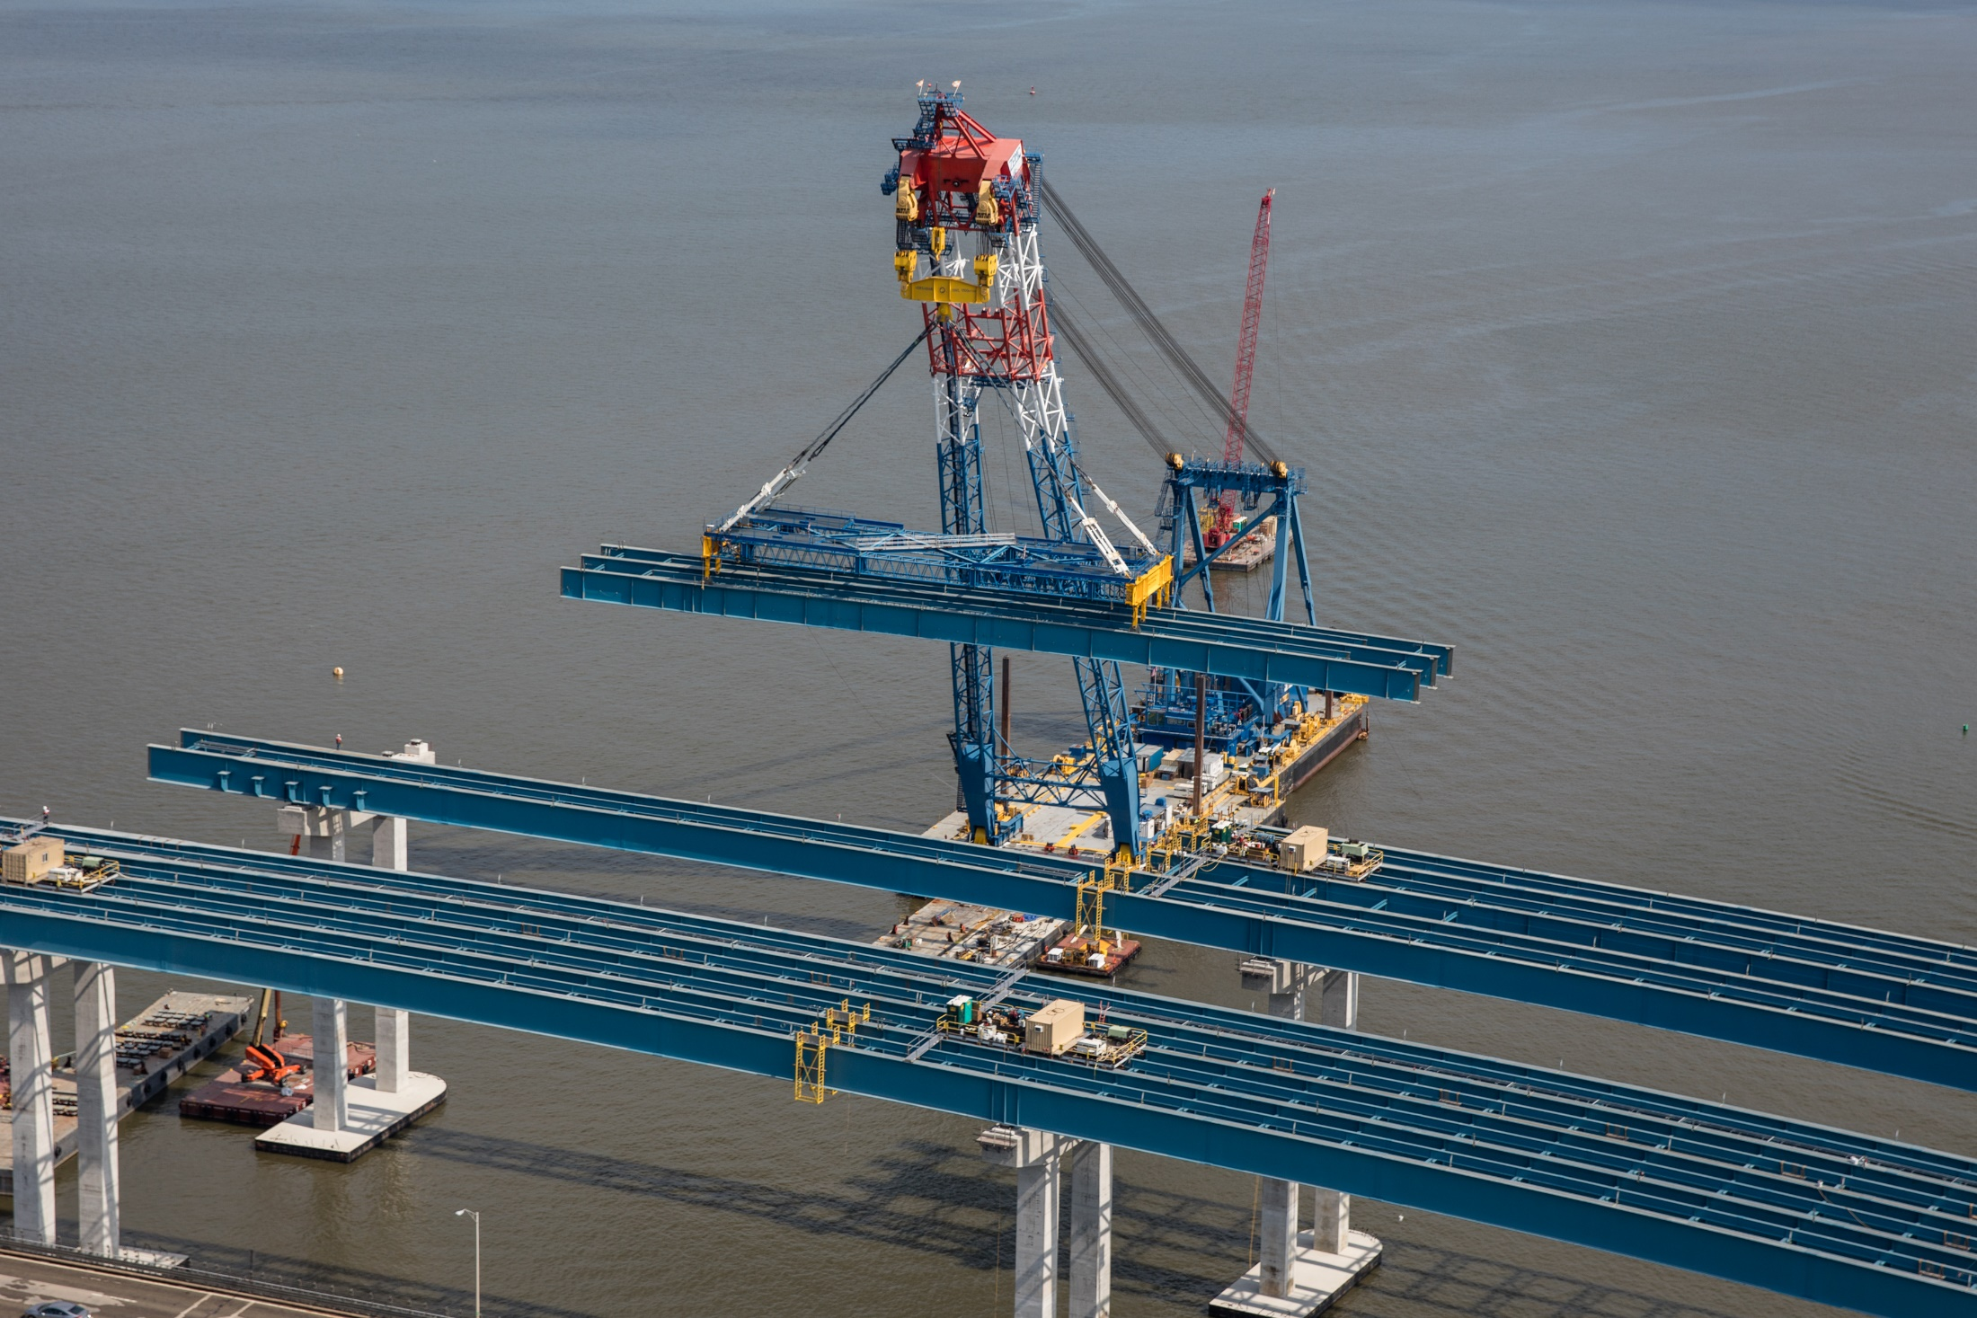
Photo 3 – (include description)

Slide 5
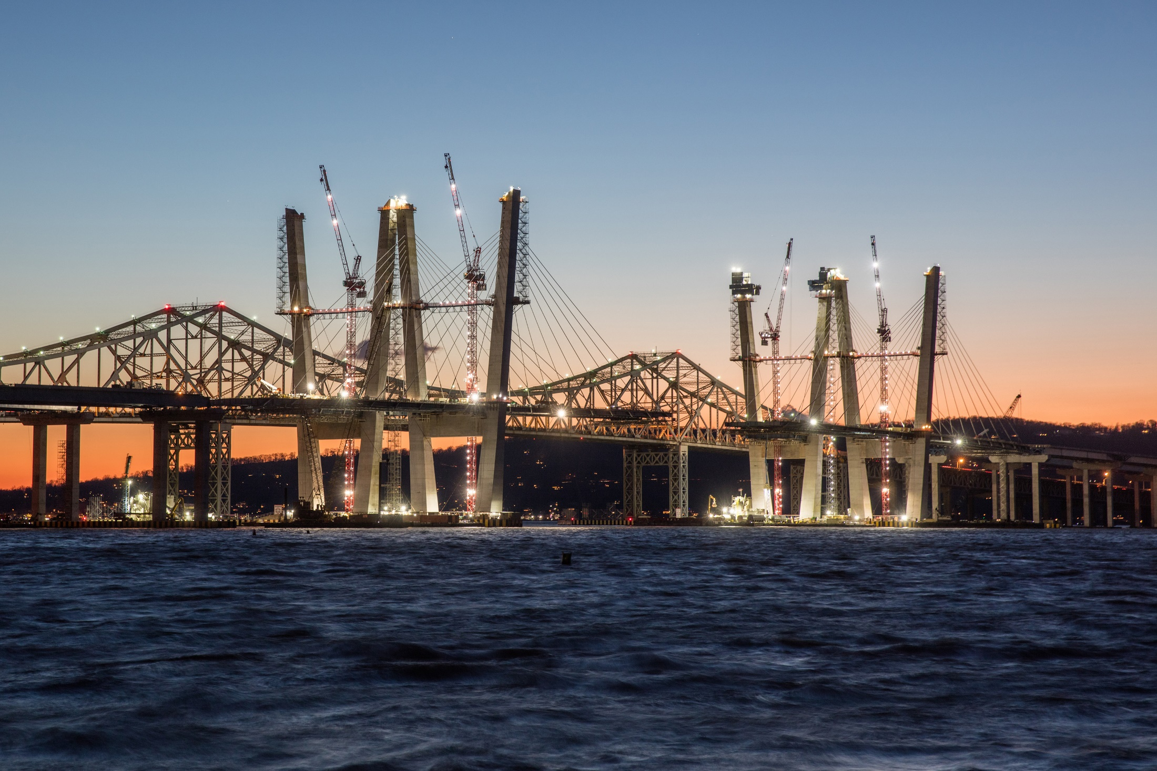
Photo 4 – (include description)

Slide 6
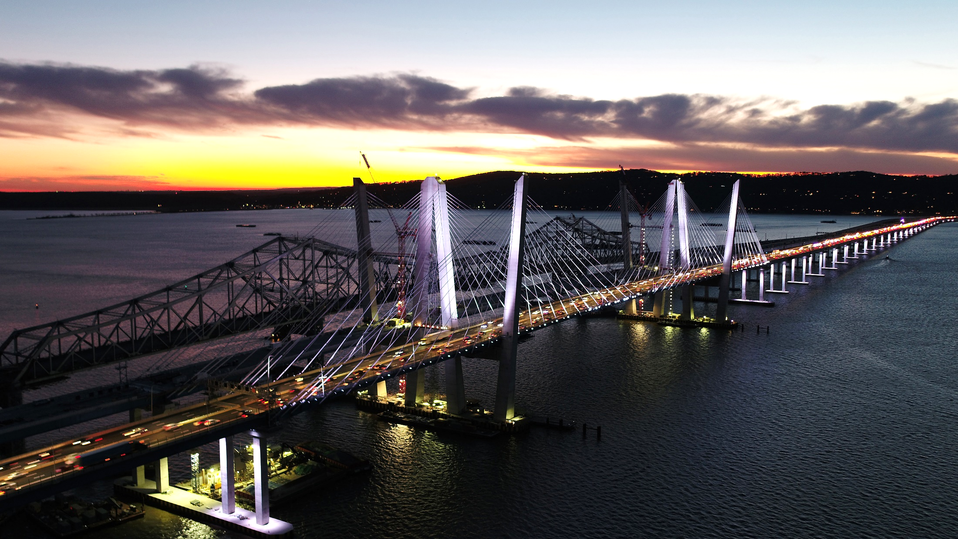
Photo 5 – (include description)

Slide 7
Photo 6 – (include description)

